Slide 1
Xplace: An Extremely Fast and Extensible Placement Framework
2024/12/04
Group1-demo3
https://github.com/cuhk-eda/Xplace

Slide 2
Outline
Introduction
Trace Codes
Build Xplace
Demo time

Slide 3
Introduction - Overview
Xplace-Route
“Upgrade” version of DREAMPlace
Routability-Driven placement flow to optimize the detailed routability.
Operator-Level optimization techniques to achieve effective parallelization.
Placement- Stage-Aware parameters scheduling to improve the solution.
Fourier-Neural-Operator (FNO), solving Poisson equation.
DreamPlace
ePlace/RePlace
ABCDPlace
ePlace/RePlace
ABCDPlace
Routability Optimization

Slide 4
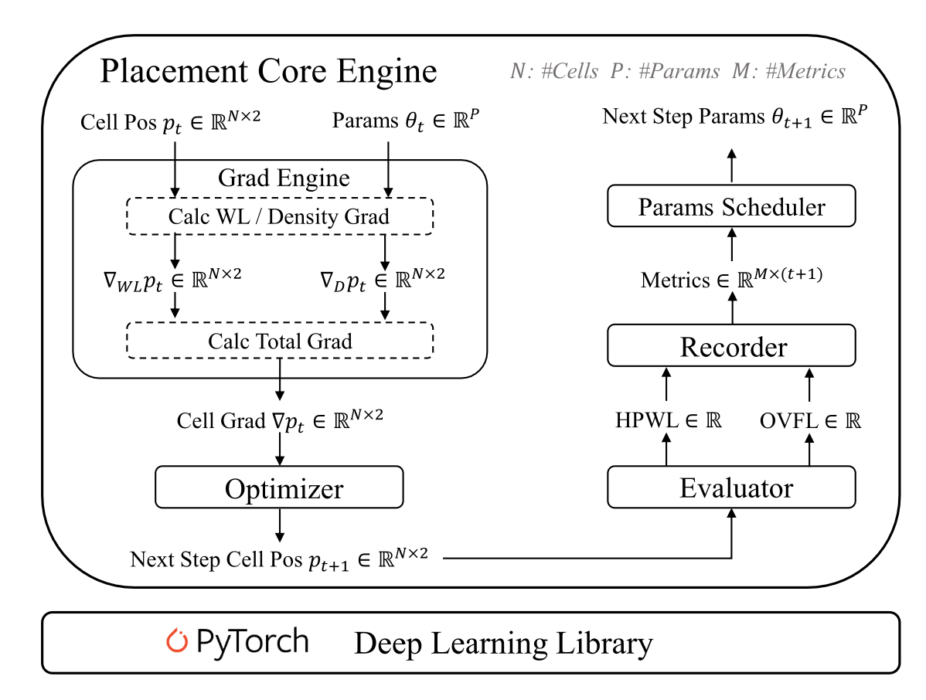
Introduction - Placement Core Engine
Placement- Stage-Aware parameters scheduler
Operator-Level optimization
Fourier-Neural-Operator (FNO)
Routability evaluation and optimization (GGR<- demo 4)

Slide 5
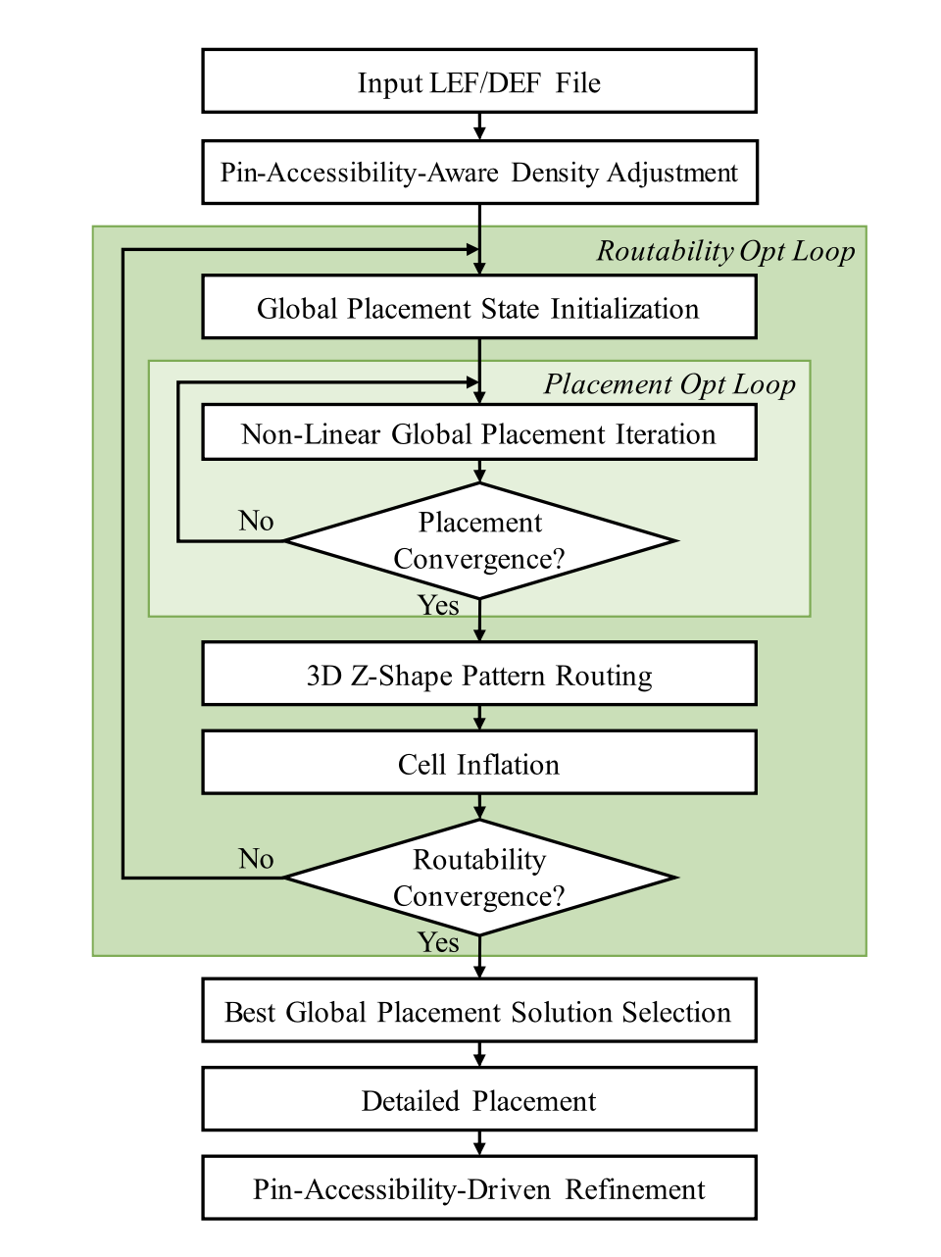
Introduction - System Flow
Routability-Driven Placement Flow
Pin-Accessibility-Aware Density Adjustment
Placement Core
Routing Congestion Map
Cell Inflation
Selects the solution with the smallest routing cost
Legalization and Detailed Placement (use ABCDPlace)
Pin-Accessibility-Driven Refinement

Slide 6
Trace Codes
Xplace/src/run_placement.py : 5
run_placement_single()
Xplace/src/run_placement_nesterov.py : 394
run_placement_main_nesterov()
global_placement_main() : 13 -> 138
Xplace/src/detailed_placement.py
Xplace/src/detail_placement.py : 727
detail_placement_main()

Slide 7
Build Xplace
conda create –name Xplace python=3.9
conda install pytorch==1.8.0 torchvision==0.9.0 torchaudio==0.8.0 cudatoolkit=11.1 -c pytorch -c conda-forge
git clone --recursive https://github.com/cuhk-eda/Xplace
cd Xplace
mkdir build && cd build
cmake .. -DCMAKE_C_COMPILER=/home/user/group1/local/gcc-7.5.0/bin/gcc -DCMAKE_CXX_COMPILER=/home/user/group1/local/gcc-7.5.0/bin/g++ -DPYTHON_EXECUTABLE=/home/user/group1/miniconda3/envs/Xplace/bin/python -DCMAKE_INSTALL_PREFIX=/home/user/group1/local/Xplace
make -j 32
make install

Slide 8
Build Xplace - Issues
Xplace github 內沒有 requirements.txt，需要自己下載package。
pip install numpy==1.26.3
pip install pandas
pip install numba
conda install matplotlib
conda install packaging
conda install seaborn
conda install pulp
conda install -c conda-forge python-igraph
要設環境變數 :
export LD_LIBRARY_PATH=/home/user/group1/miniconda3/envs/Xplace/lib:$LD_LIBRARY_PATH
否則裝package會一直發生錯誤。

Slide 9
Build Xplace - Issues
CMakeLists.txt 沒有偵測 gcc、g++版本，需要手動指定路徑。
Xplace 不能設定安裝檔路徑 。
原始碼有錯，需要修改

Slide 10
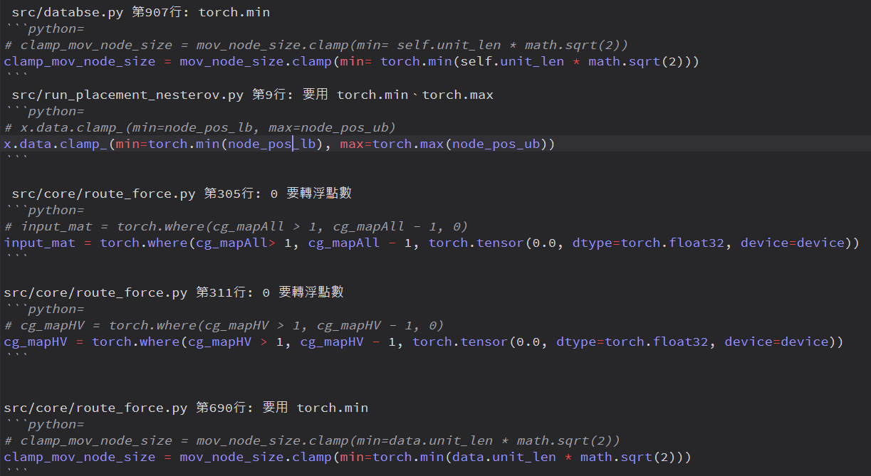
Build Xplace - Issues
原始碼有錯，需要修改

Slide 11
Demo Time
To run GP + DP flow for ISPD2019 dataset:
python main.py --dataset ispd2019 --run_all True
To run Routability GP + DP flow for ISPD2019 dataset:
python main.py --dataset ispd2019 --run_all True --use_cell_inflate True
若要只跑特定 design :
--run_all True => --design_name ispd19_test1

Slide 12
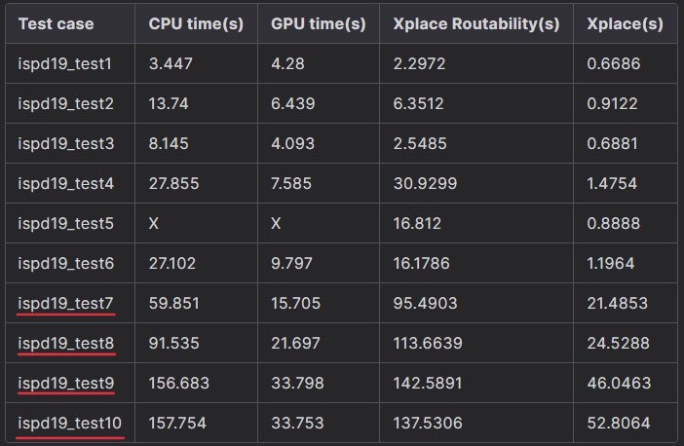
Demo Time
Run time of GP and LG :
Parameters:
iteration : 1000
learning rate: 0.01

Slide 13
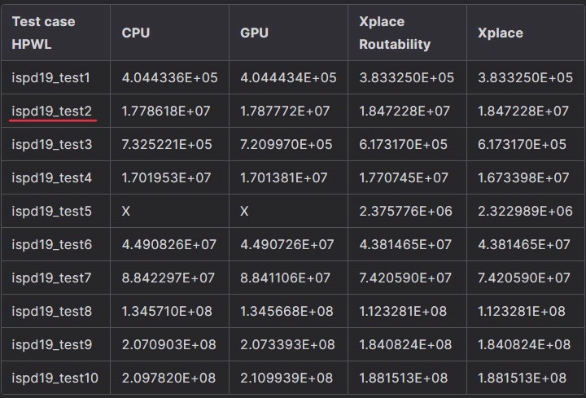
Demo Time
Global placement HPWL of each test case:
Parameters:
iteration : 1000
learning rate: 0.01

Slide 14
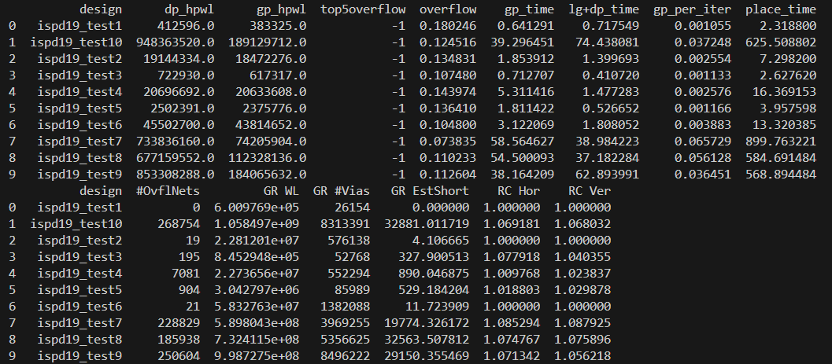
Demo Time
python main.py --dataset ispd2019 --run_all True --load_from_raw True --detail_placement True --use_cell_inflate True --final_route_eval True
GP + DP + GR
iteration: 10000
learning rate: 0.01

Slide 15
Demo Time

